Slide 1

Emerging themes and first ideas
TMT | Western Europe
HIT025
Working draft based on interviews as of 12/01/2017
Client: Personalized inventory management using analytics
GLOBAL MARKETING & SALES
Document for discussion | 15/01/2018
Katharina Schumacher
CONFIDENTIAL AND PROPRIETARY
Any use of this material without specific permission of McKinsey & Company is strictly prohibited
CONFIDENTIAL AND PROPRIETARY
Any use of this material without specific permission of McKinsey & Company is strictly prohibited

Slide 2

We used analytics to personalize seller management on a large scale
HIGH TECH (TMT) | WESTERN EUROPE
HIT025
Client
Situation
Context: Large e-commerce player with business across various verticals and categories for B2C as well as C2C
Objective: sales push for B2C segment
Complication: Although abundance of analytics and different dashboards available, no structured analytical inventory approach on SKU level
What we did
Impact
By bringing in advanced analytics expertise we:
Developed holistic and personalized inventory management approach on single SKU and seller level
Identified target inventory to focus on an developed levers and recommended actions
Used structured approach to select sellers to contact and created materials for outreach
Made SKUs competitively priced SKUs visible to customers
Piloted pragmatically using simple Excel sheets and 2 outreach campaigns
Pilot in 2 weeks
13,000 SKUs identified as prioritized target inventory
About 200 sellers contacted in 2 weeks
More than 5,000 competitively priced SKUs identified and uploaded into Deals in a few days
~12%+ revenue impact in first few weeks

Slide 3
Our objective was to test and learn end to end inventory cycle approach for best-selling SKUs
Inventory
pyramid
Best
Selling
Identify
Source
Surface
Market
Strategic
Propositions
Objectives
Emerging categories
Test and learn end to end inventory cycle approach for best-selling SKUs
Target top SKUs to ensure and promote right stock at right prices
Long tail

Slide 4
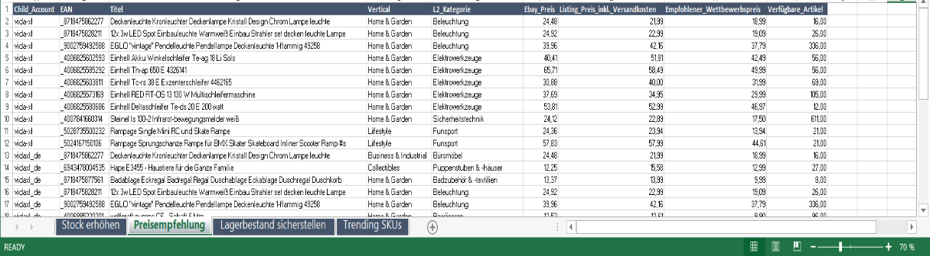
In the pilot, we pragmatically used a simple Excel to provide personalised seller reports with SKU recommendations to target sellers
1
2
3
4
1
Increase stock
2
Reduce Price
3
Ensure stock
4
Trending SKUs
Lists topselling items for which stock is 0.
ACTION Seller should increase stock
Shows topselling items which are overpriced
ACTION Seller should try to decrease prices
These items are particularly strong
ACTION Seller should make sure to have enough stock
Hot items for most relevant L2 categories on child account level
ACTION Seller should use list to find potential gaps in his portfolio

Slide 5
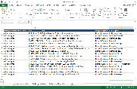
We reached out via email and calls to 172 unmanaged sellers that cover 7,000 SKUs
Reached 172 VIP and High Value sellers, # of SKUs covered
Sellers receive individualized Email with seller specific report and explanation
Increase stock
143
1
Download link to PDF which explains seller report
2
Download link to individual seller report
Reduce price
2,970
Ensure stock
3,134
Total¹
6,187
First results
Open rate: 40% (equal to >10pp more than average)
1
2

Slide 6
Targeting sellers with clearly prioritized SKUs and clear recommendations proved to be very effective
Daily revenue change before and after outreach
Test group
Contacted sellers
Prioritized SKUs that changed
Pilot results¹
Wave 4 outreach results²
70%
296%
58%
Control group 1
Contacted sellers
Other non-prioritized SKUs
Control group 2
Non-contacted sellers
Prioritized SKUs that changed
16%
13%
Since the pilot there have been 8 further waves of outreach
They contacted 2000 sellers (now increasing to 4000) via emails and calls
This has strengthened the results for the test group
6%
Test group
Control group 1
Control group 2
Test group
Control group 1
Control group 2
1 Before = Oct 18-Oct 25 2016, and after = Oct 26-Nov 22 2016
2 Before = Oct 18-Oct 25 2016, and after = Feb 16-Feb 22 2017
3 Control group based on same SKUs as test group, however, only for 137 out of 194 SKUs transactions have been made in control group 2

